Slide 1
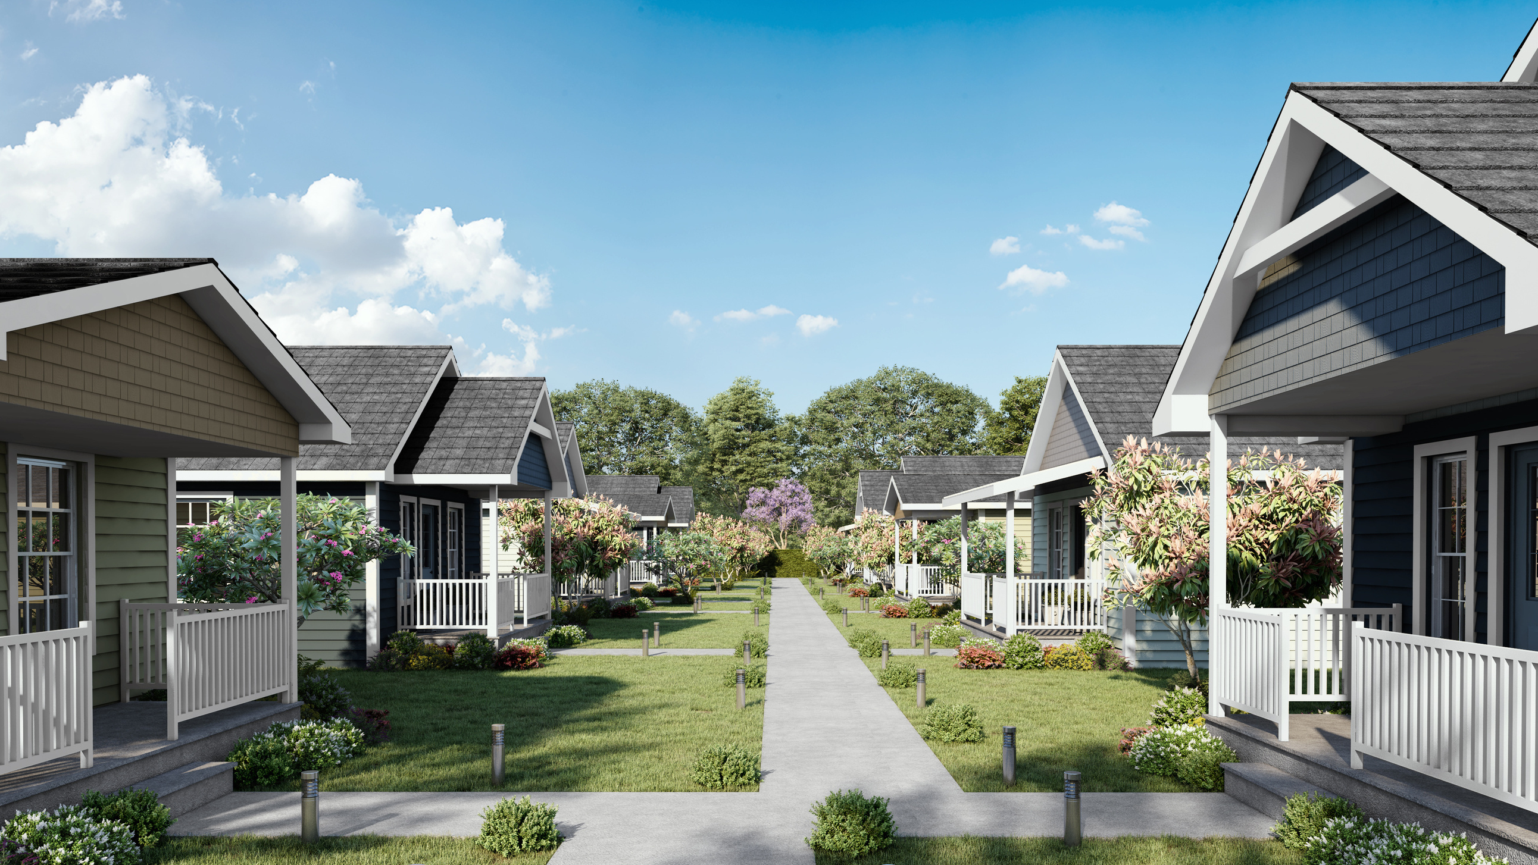
Cottages on Grove

Slide 2
COTTAGES ON GROVE
A micro-community of homes designed to meet the specific needs of our community's at-risk youth. The collection of homes will consist of ten 600 sq.ft. cottages. They will help Forward Paths to further their mission to positively influence at-risk youth and set them on a path to independence.

Slide 3
WHAT THE COTTAGES WILL MEAN FOR OUR COMMUNITY
The lack of affordable housing continues to create barriers for many people in our community. Without a place to live, self-sufficiency isn't possible. These cottages will provide a stable and secure home for the young people in our program. Having our own housing provides us with the ability to house them immediately in a place that we know and trust. These homes will provide a safe environment for them to grow and to learn how to live independently.
Exterior Rendering

Slide 4
10 TINY HOMES
While all of the floorplans will be similar, each of the
tiny homes will have its own unique decor and style,
both interior and exterior.
All of the homes will have:
600 sq.ft. of living space
2 Bedrooms
1 Bathroom
Full kitchen
Front porch
Exterior storage space

Slide 5
Project Overview
In 2019, First United Methodist Church of Eustis donated an entire city block to Forward Paths so that
we could further our mission to house our community's young adults in need. In addition to the 10 tiny homes that we will construct, the site also consists of two existing homes which are currently occupied by our youth and one detached garage with an outdoor picnic area. When the project is complete, we will also have an additional storage building, a parking lot, and a community garden.

Slide 6
We are thrilled to announce that we have partnered with HomeAid to build Cottages on Grove.
Not only do HomeAid's values and vision align with our own, they also brings a wealth of knowledge and expertise in home building. The best home builders in the area will be assisting with the construction of these homes.
HomeAid’s mission is to help people experiencing or at risk for homelessness build new lives through construction, community engagement, and education.

Slide 7
We believe that everyone should have the opportunity to live up to their full potential.

Slide 8
Please reach out to us
for more information.
MAILING ADDRESS
Forward Paths Foundation
PO BOX 492109
Leesburg, FL 34749-2109
PHONE NUMBER
(352) 801-8631
EMAIL
info@forwardpaths.org

